Slide 1
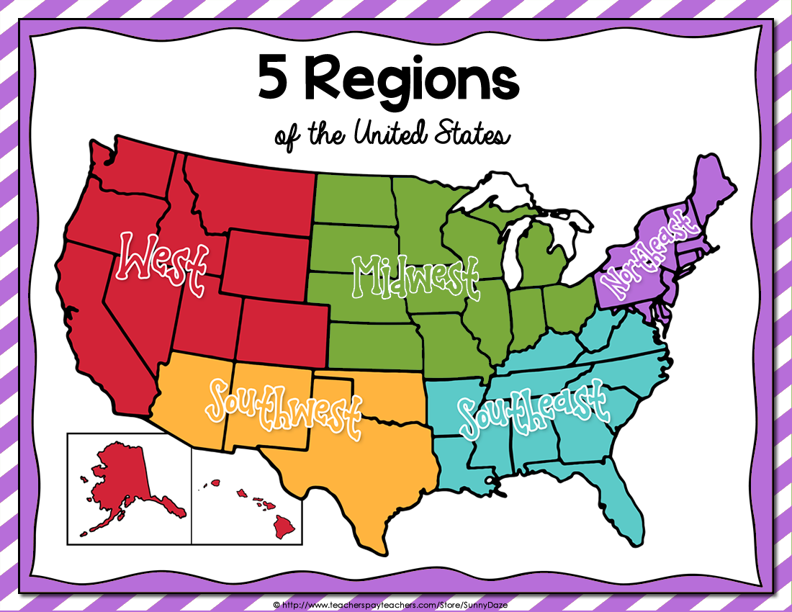

Slide 2
Maine
New Hampshire
Vermont
New York
Pennsylvania
Maryland
7. Delaware
8. New Jersey
9. Connecticut
10. Rhode Island
11. Massachusetts

Slide 3
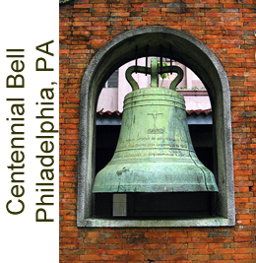
The History
The first European settlers arrived in the early 1600s.
Native Americans had been living on that land for thousands of years before the settlers arrived at Plymouth Rock.
The northeastern settlements became part of the original 13 colonies.
The first shots of the American Revolution were fired in Lexington, Massachusetts. After winning independence from England, the colonists formed a new government and wrote the United States Constitution.

Slide 4
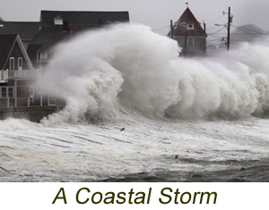
Climate
The Northeast region has distinct weather changes for all four seasons.
Winter: Cold with lots of snow. The further north you travel, the more snow you will see.
Spring: Air begins to warm. The ground unthaws. Plants begin growing again.
Summer: Warm and humid.
Fall: Many trees’ leaves change color and fall to the ground. Temperatures become cooler.
This region can have some very powerful storms. In the warmer months hurricanes might form. In the colder months blizzards and nor’easters can cause great damage.

Slide 5
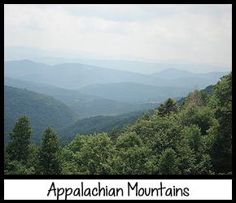
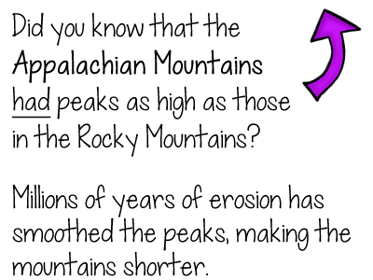
The Land
The Northeast contains:
Mountains
Hills
Forests
Grasslands
Lakes
Rocky Beaches
Sandy Beaches
Flat fertile farm land

Slide 6
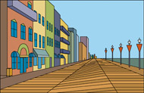
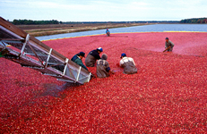
Economy
Major industries include:
Fishing
Tourism
Farming
Lumber
Manufacturing
Mining
Coal
Stones
Iron Ore (minerals and rocks from which iron and other metals can be extracted)

Slide 7
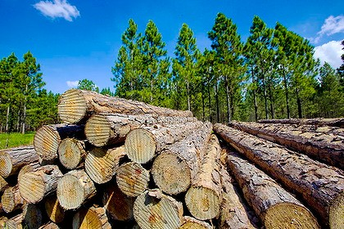
Natural Resources
Natural resources are materials that are found in the environment.
Natural resources found in the Northeast include:
Coal (mined from the ground)
Stones (mined from the ground)
Minerals (mined from the ground)
Forests (lumber)
Water
A renewable resource is one that we won’t run out of naturally.

Slide 8
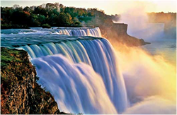
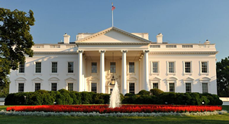
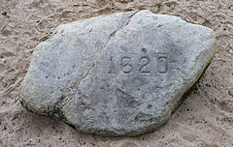
Landmarks
Landmarks are important places.
They can be man-made things such as a monument.
They can be historical locations.
They can be things created by nature that are unique in some way.
There are many important landmarks found in the Northeast. Some examples include:
Notes:
Landmarks pictured: Niagara Falls, International border between New York state and Ontario, Canada – The White House, Washington, D.C. – Plymouth Rock, Massachusetts

